Slide 1
PyCon/APAC 2022
David Mikolas
Molecular Dynamics with Python
"Molecular Dynamics is no longer scary with Python!
Learn to do it yourself with FIRE and LAMMPS."
00:00

Slide 2
PyCon APAC 2022
Thank you to Teng-Lin Yu 游騰林, the whole program committee, and everyone who contributed to making PyCon APAC 2022 possible.
Recording in July for viewing in September: it won’t be as fancy of a talk as initially hoped
Updated slides and link to Github (Python & Blender scripts)

Slide 3
I want to thank Professor Shu-Jung Tang 唐述中 for his support and providing a truly interesting research environment where we can explore questions about the structure and behavior of 2D materials.
Thanks also to all of his students for all their hard work and contributions to the research.

Slide 4
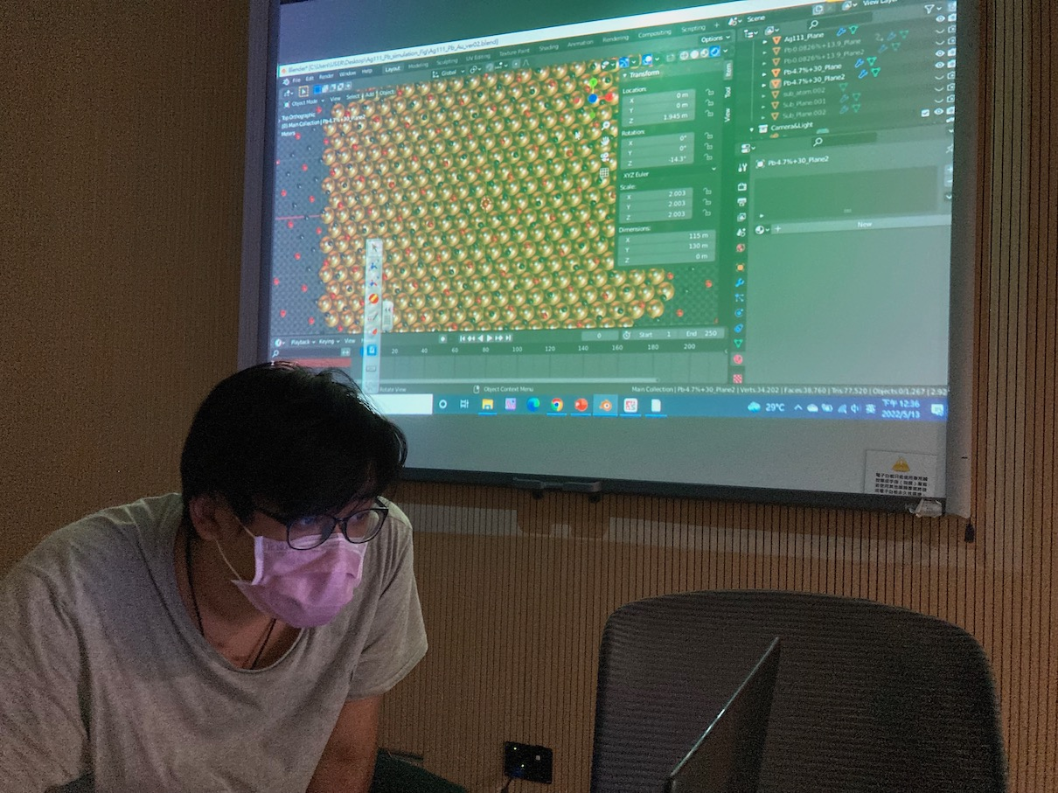
Thanks especially to Jia-Ying Li 李嘉穎 for his help with Blender+Python

Slide 5
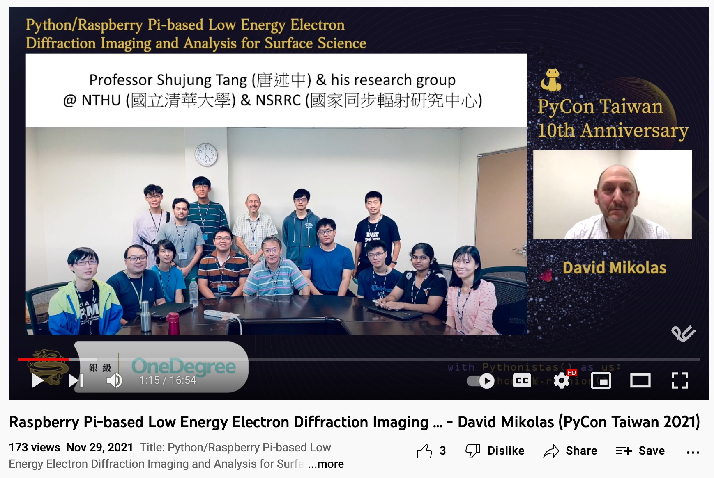
https://www.youtube.com/watch?v=zFUINzoyMzg

Slide 6
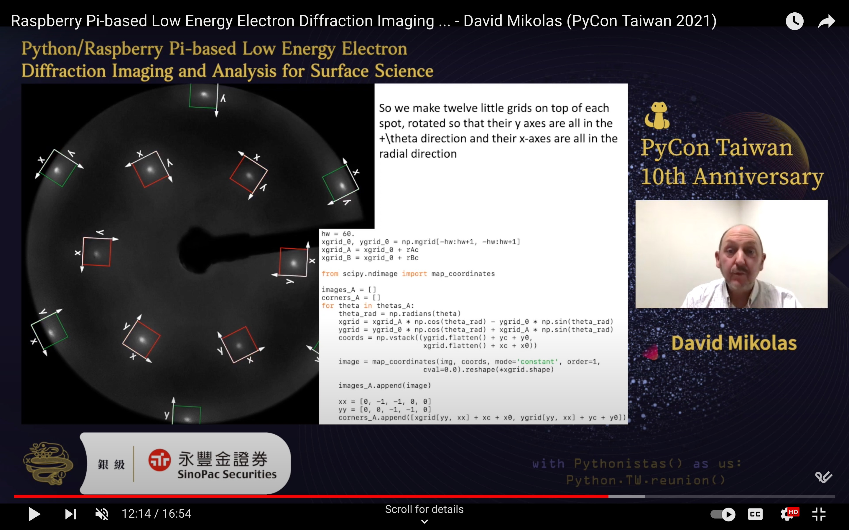

Slide 7
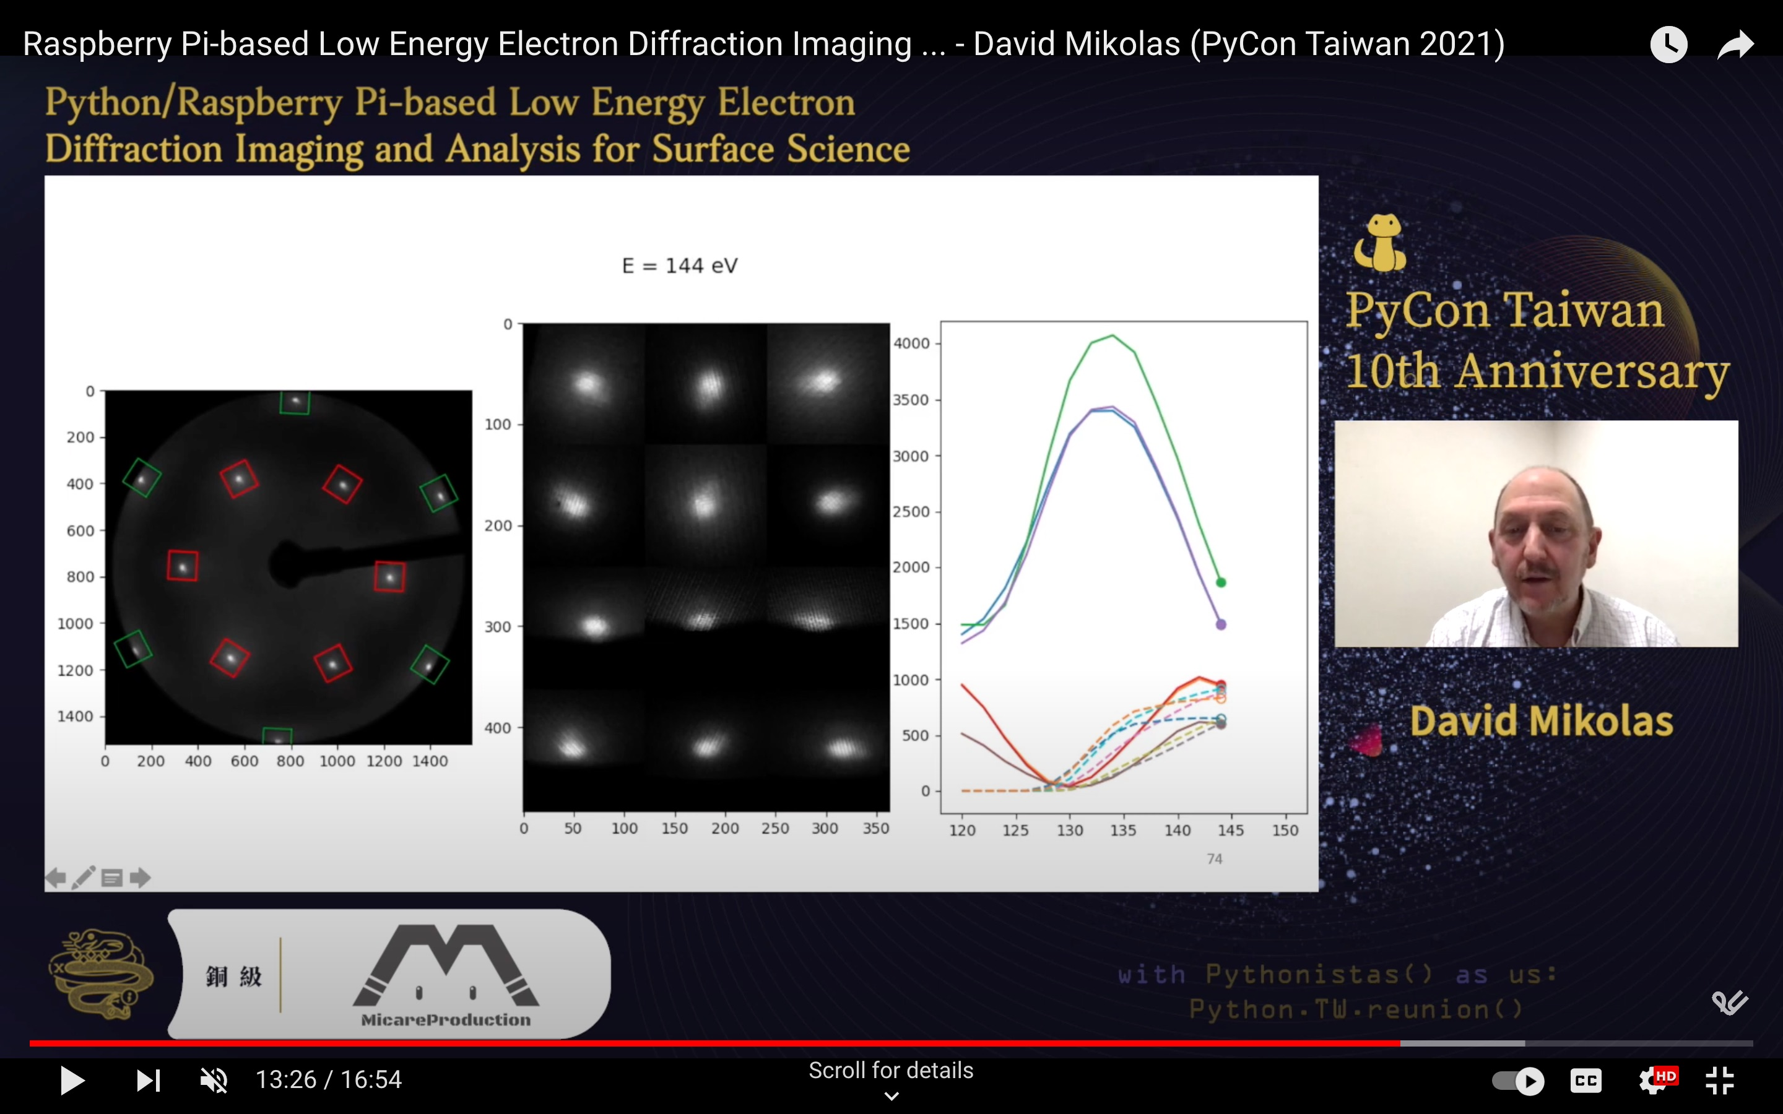

Slide 8
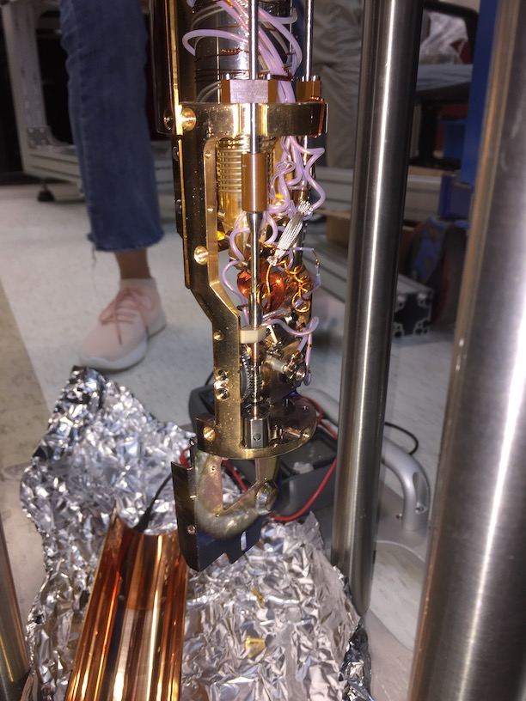
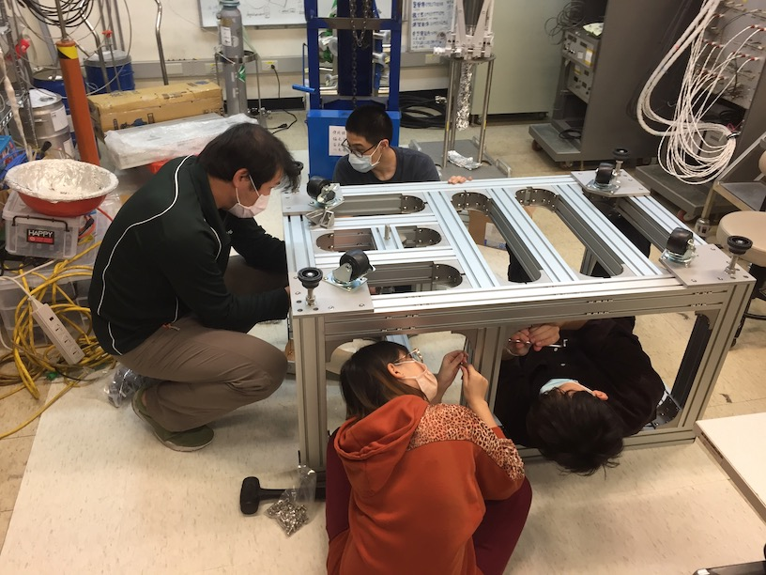
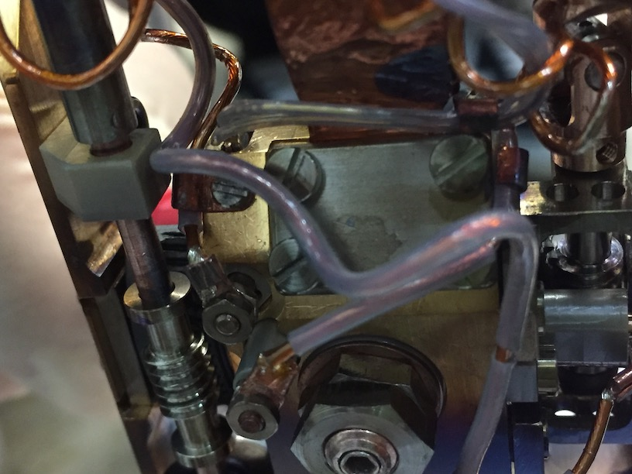
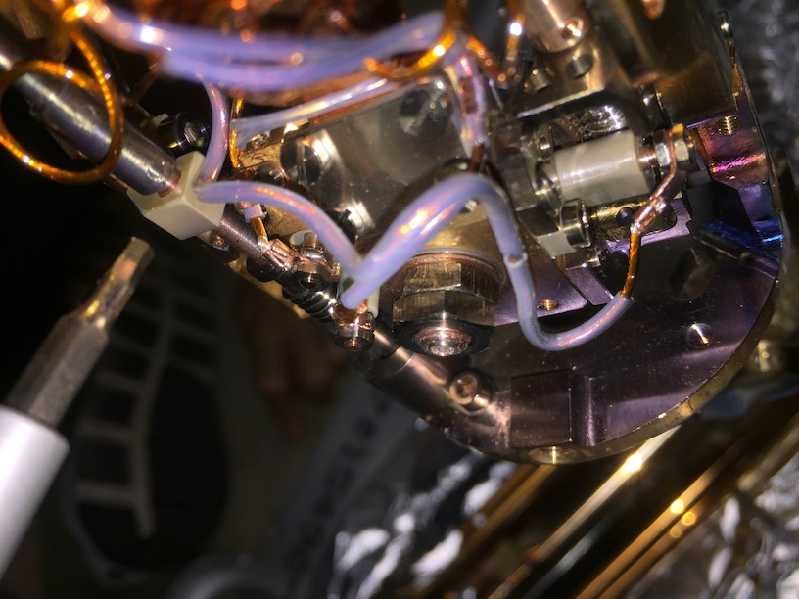
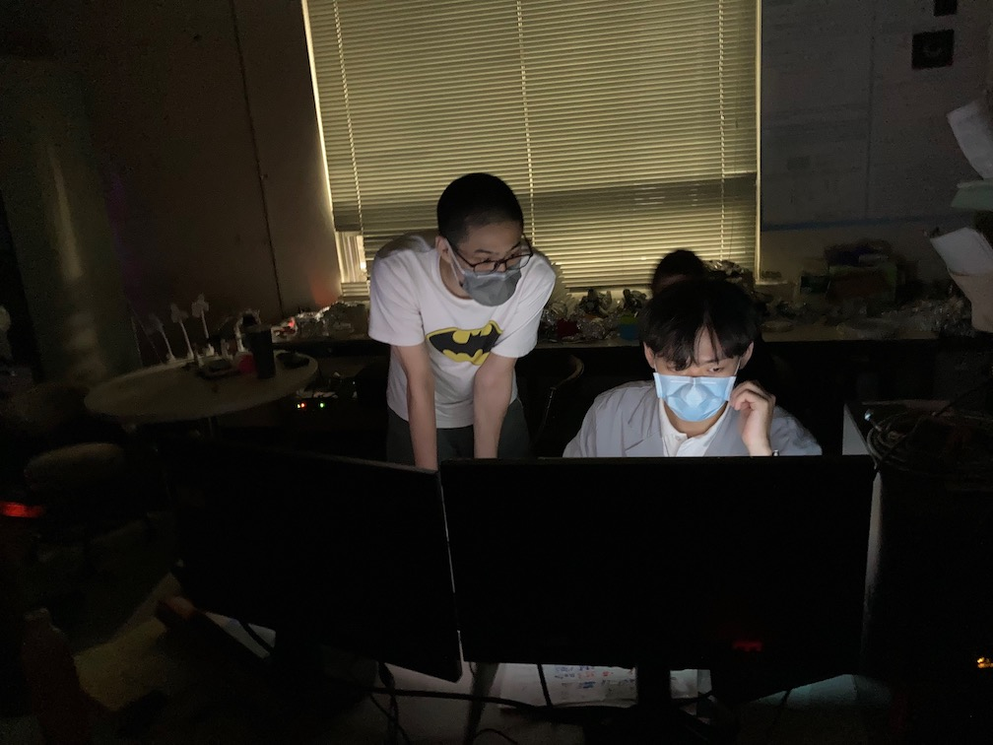
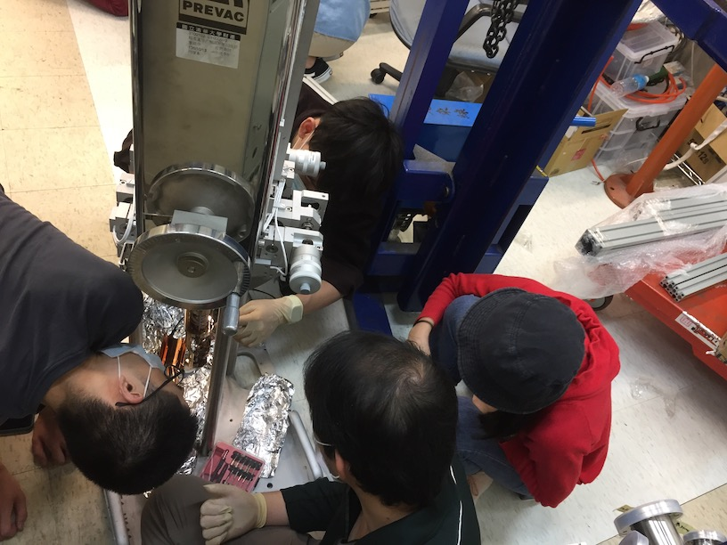
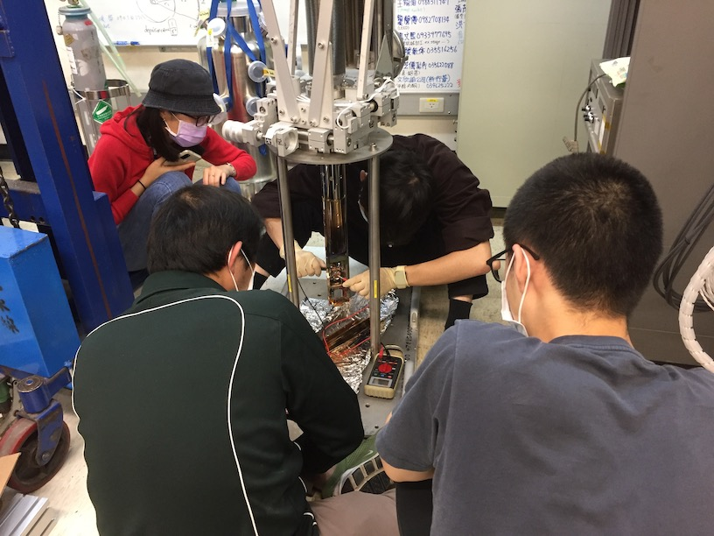

Slide 9
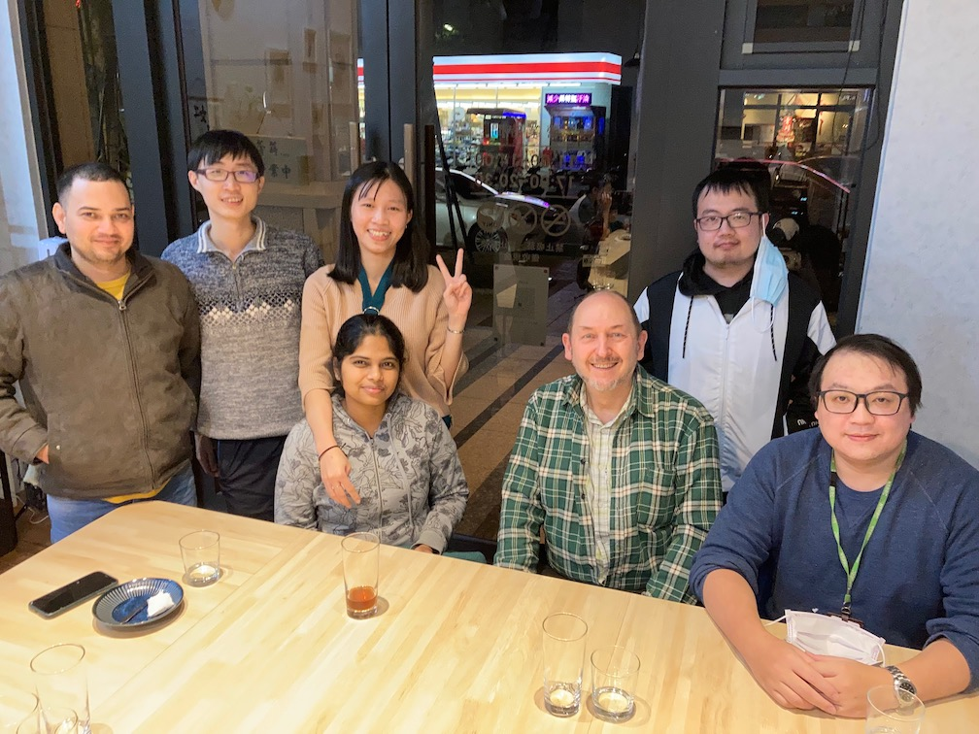
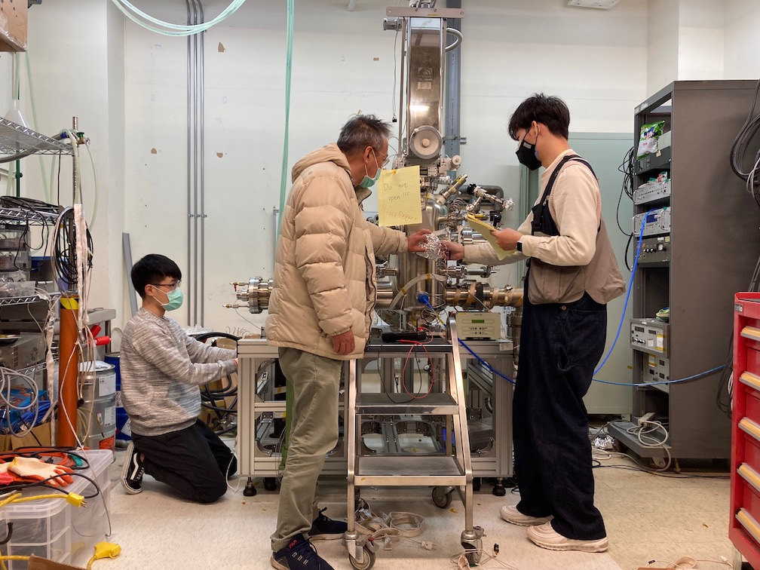
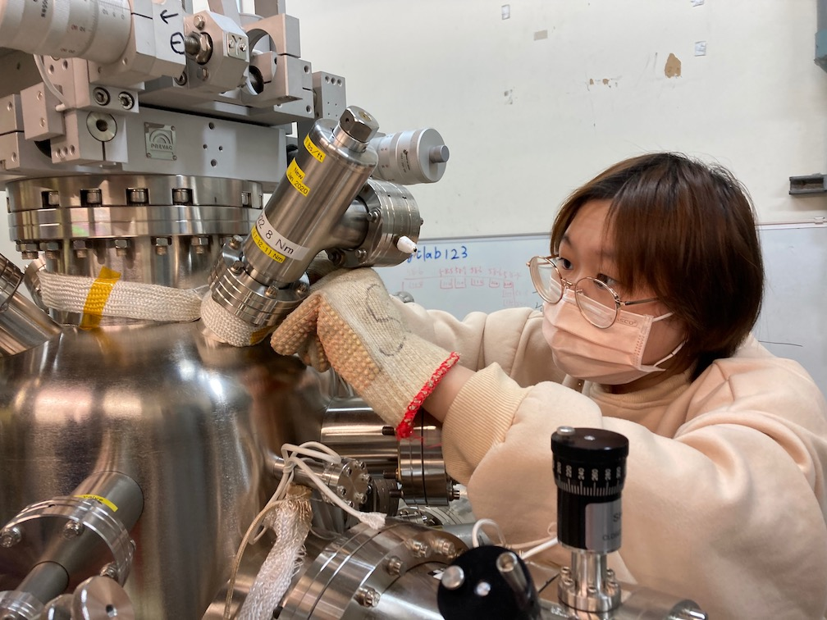
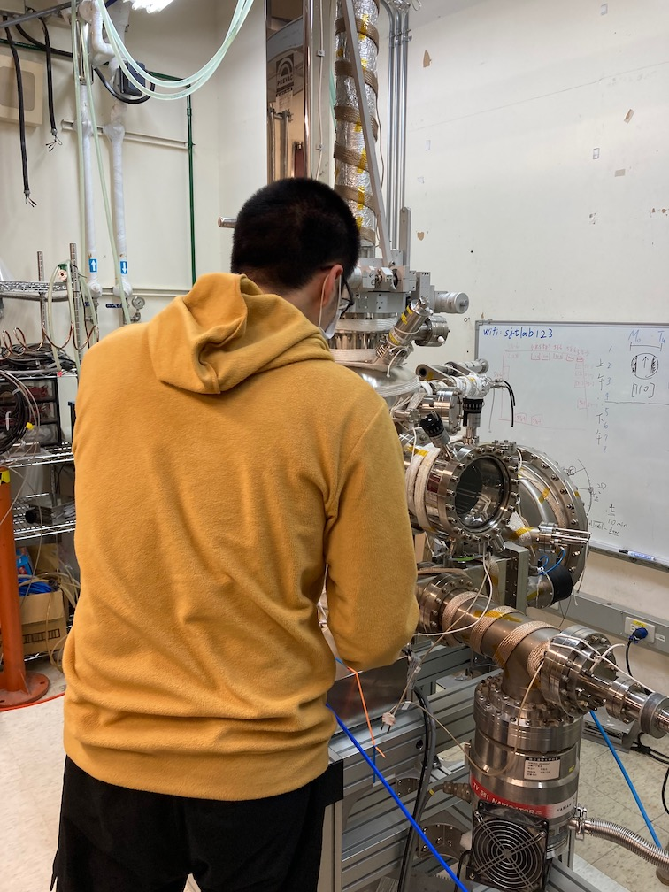
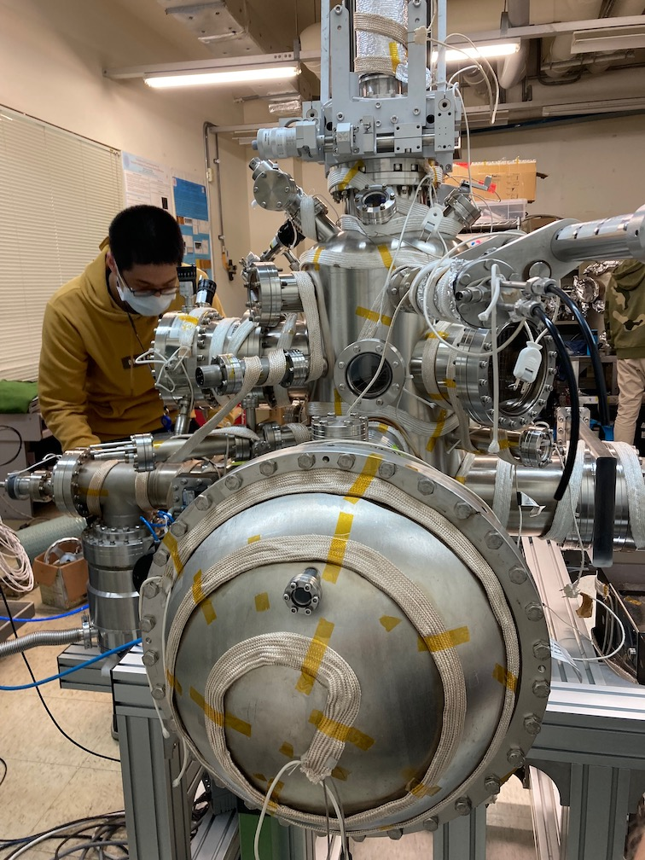
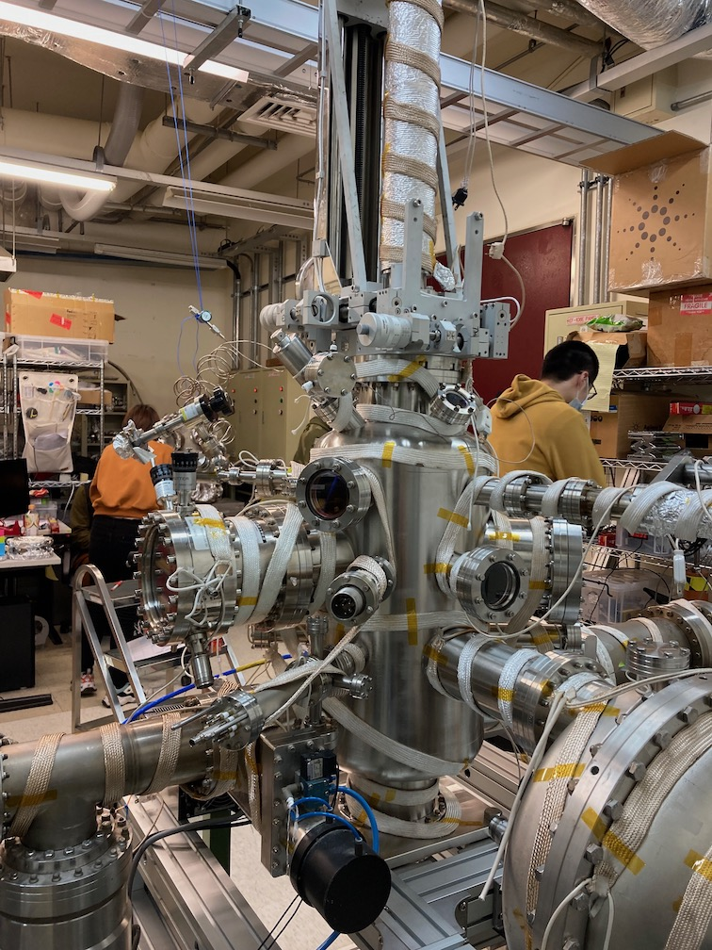
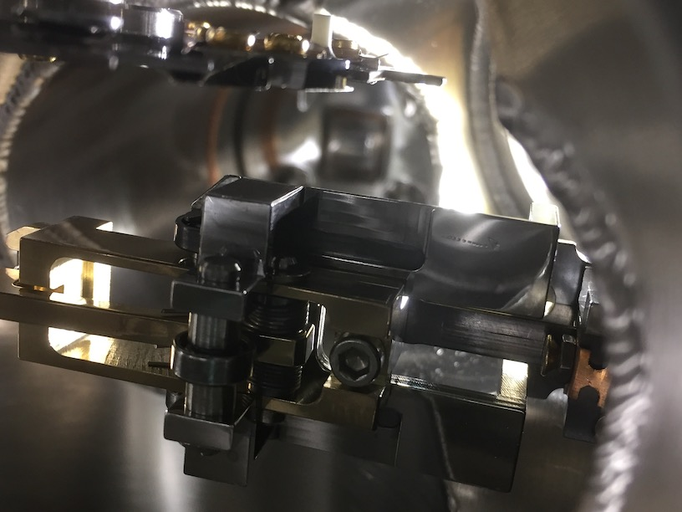

Slide 10
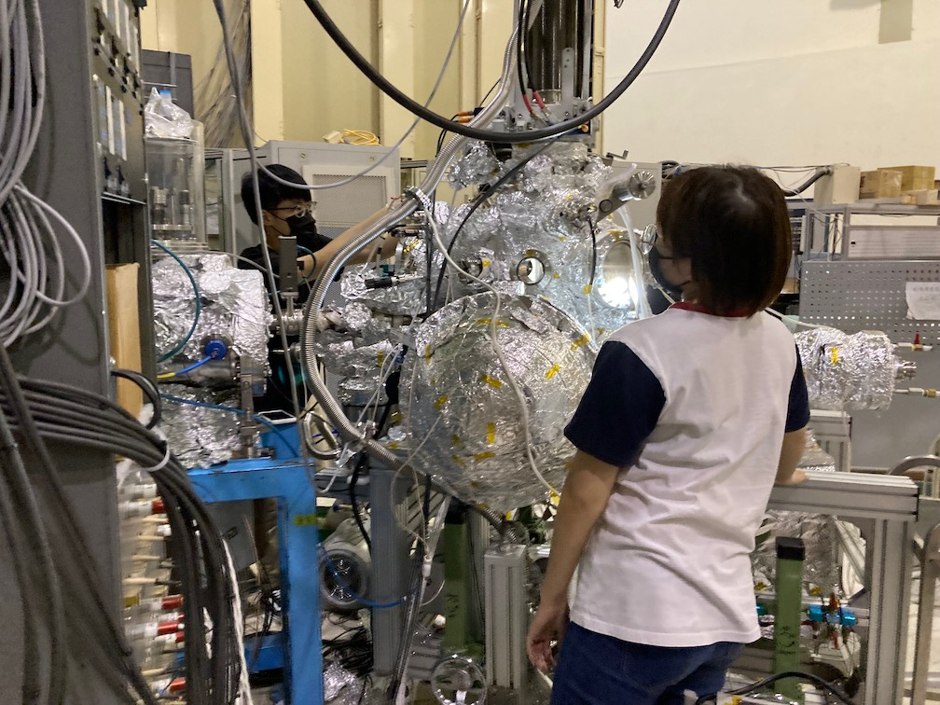
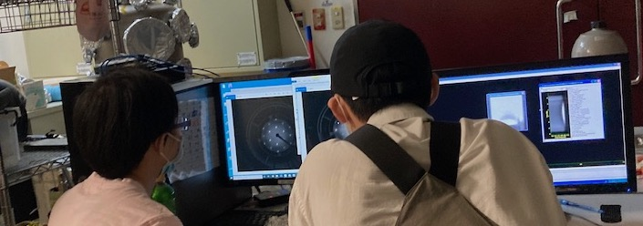
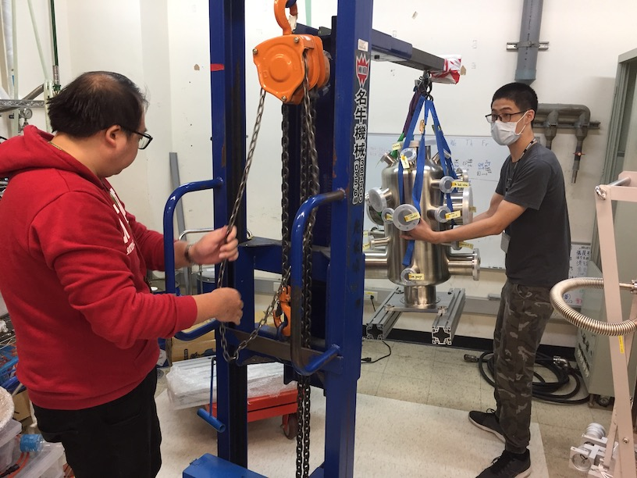
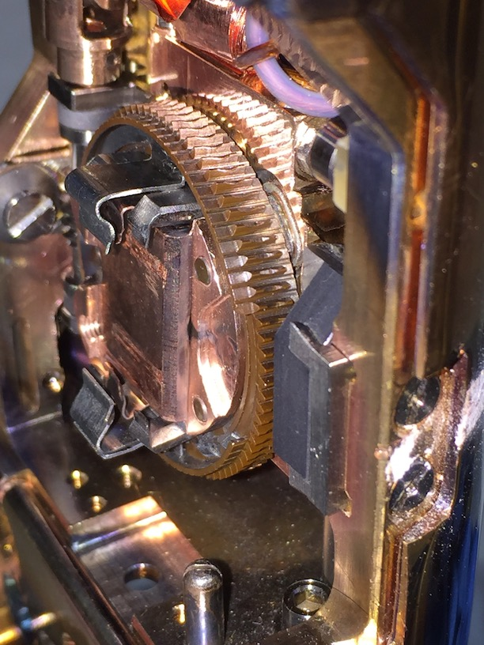
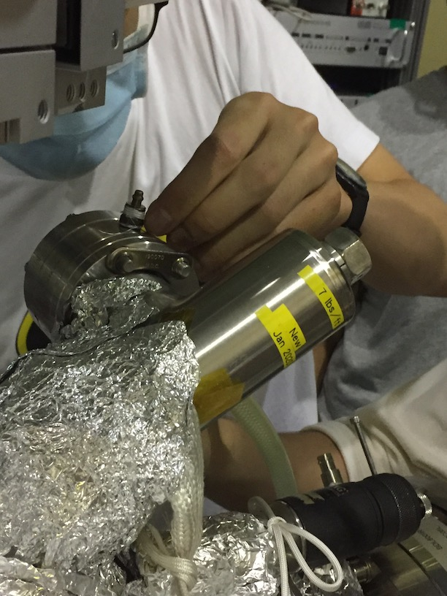

Slide 11
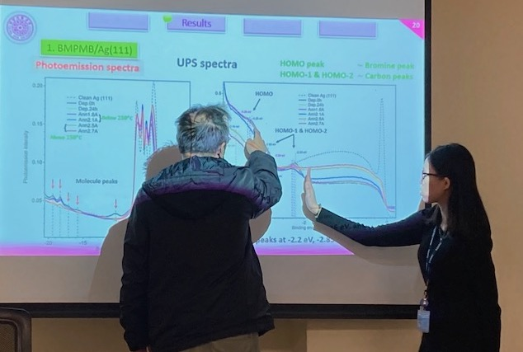
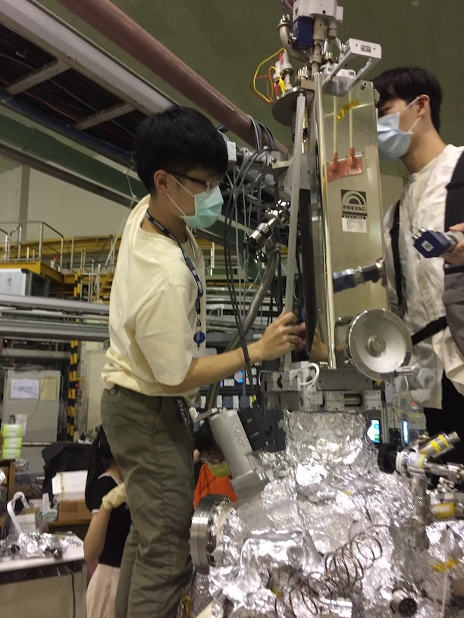
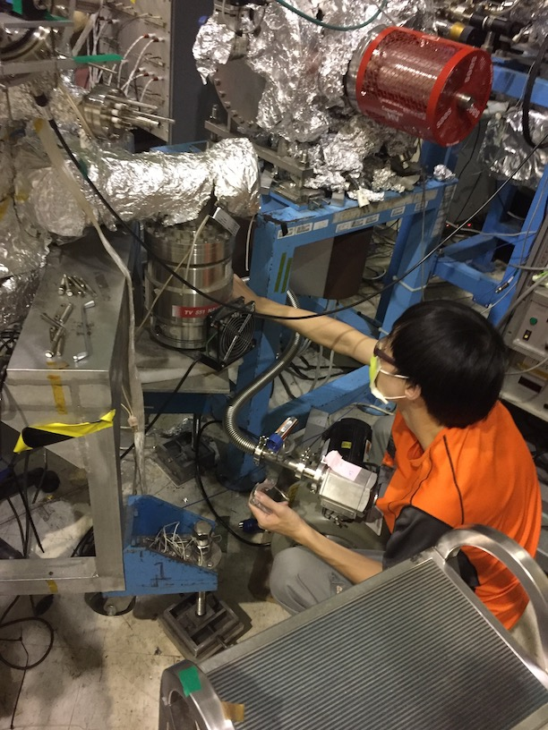
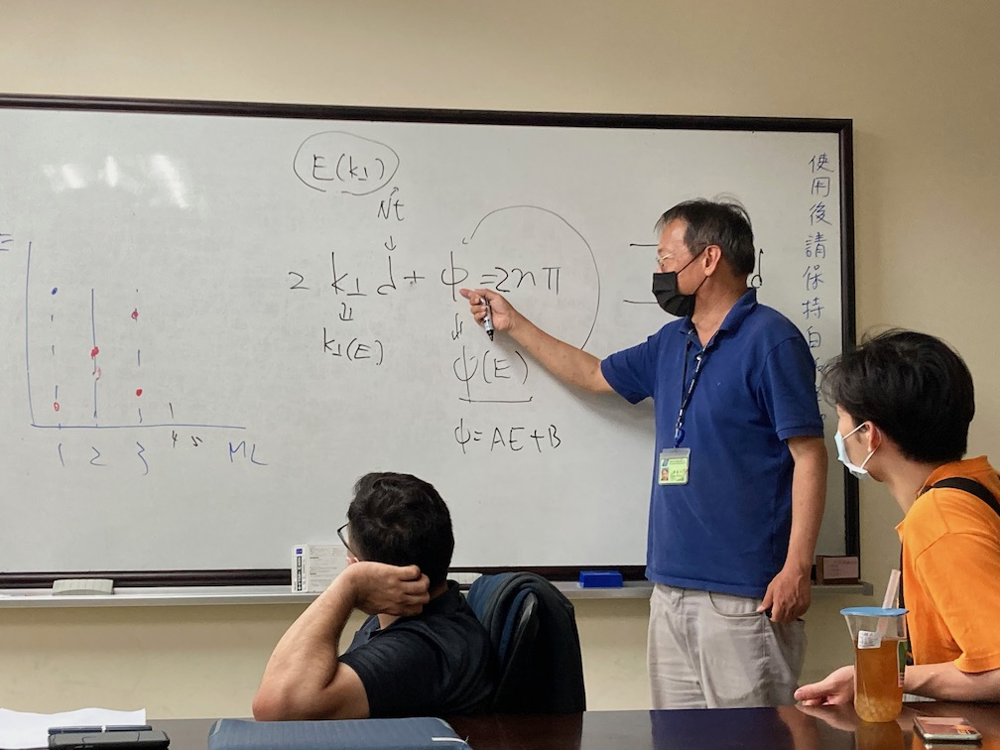
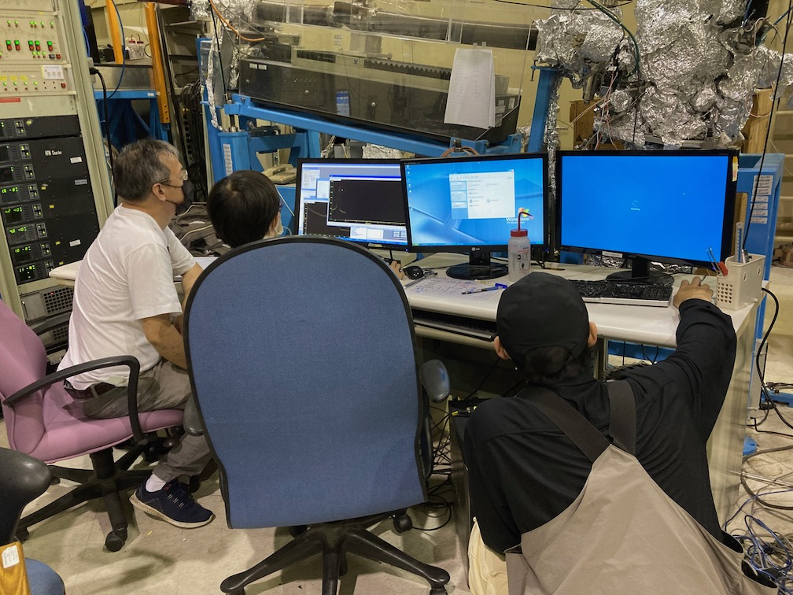
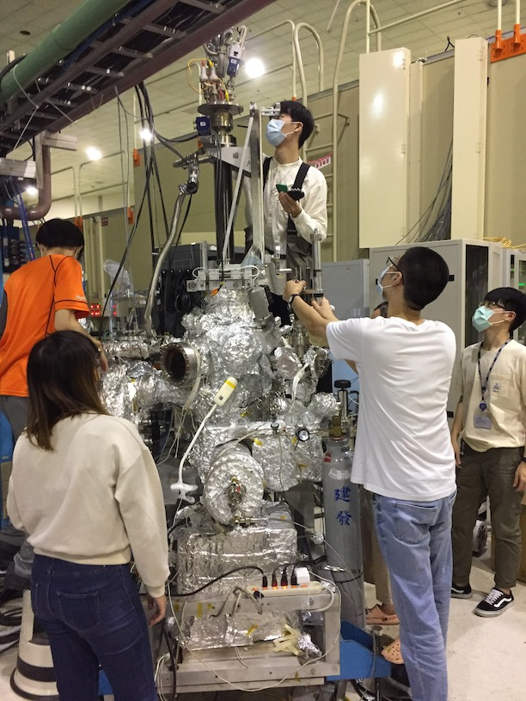

Slide 12
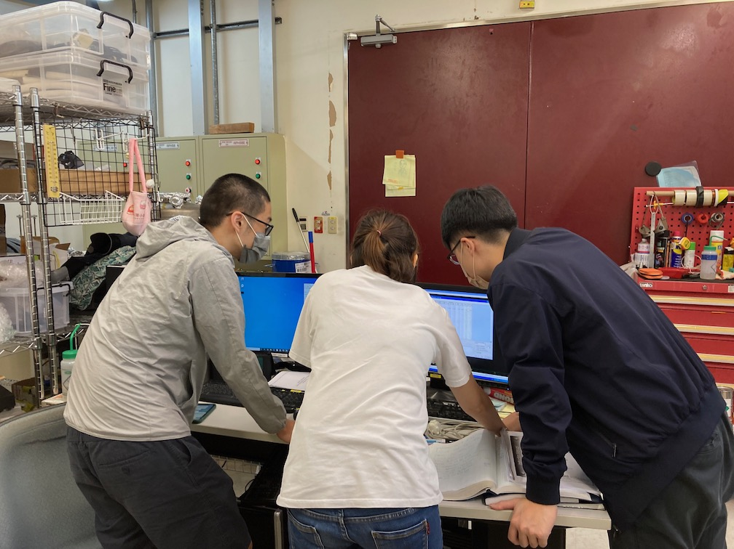
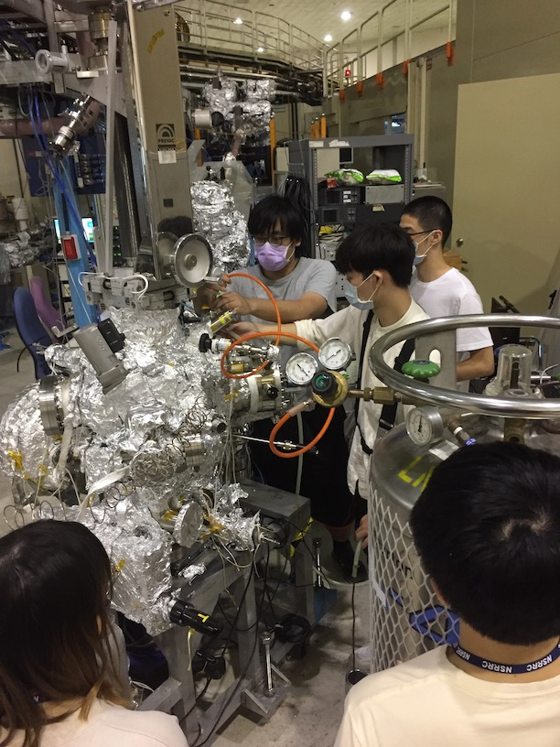
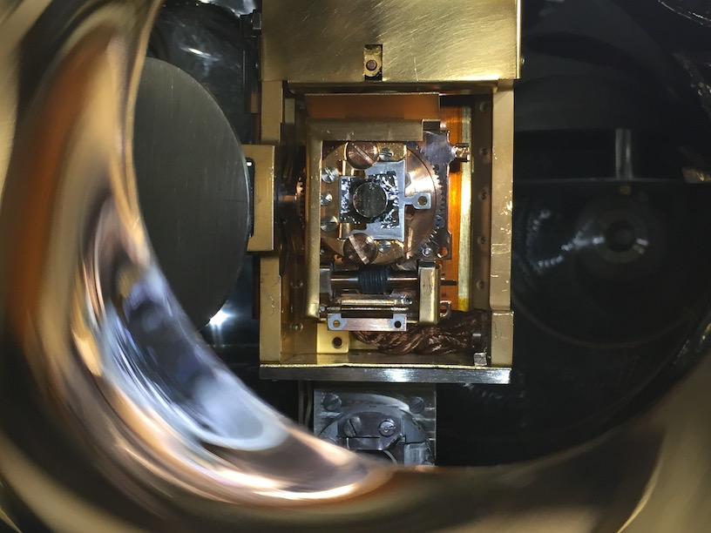
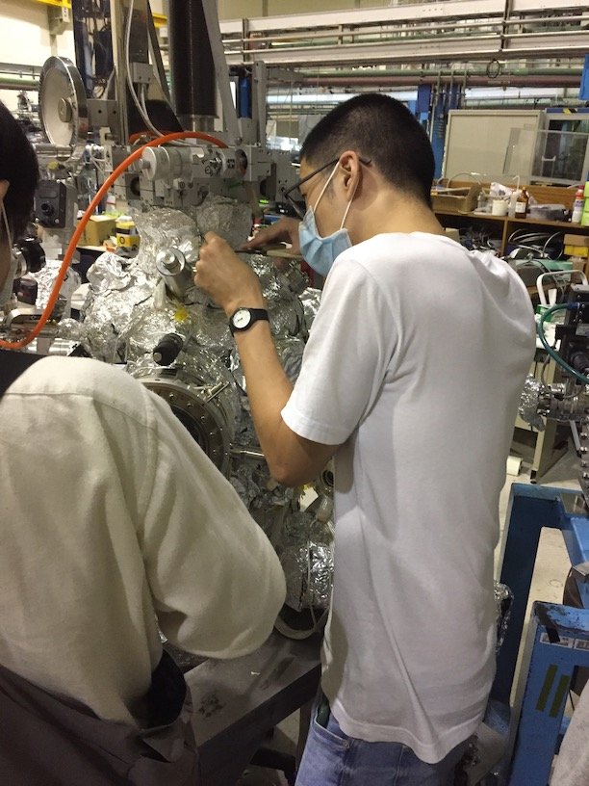
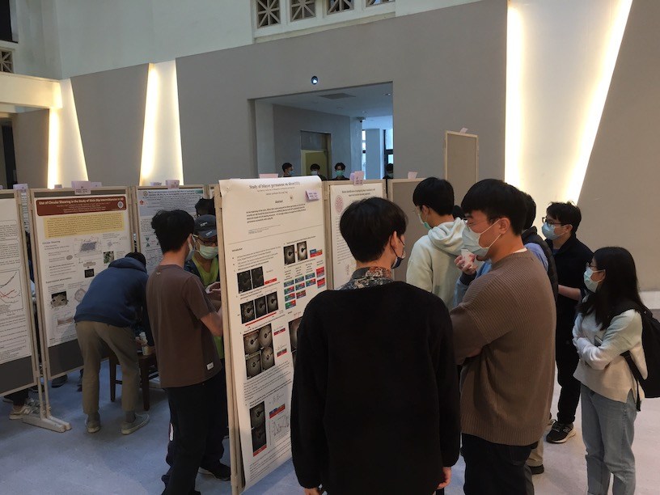
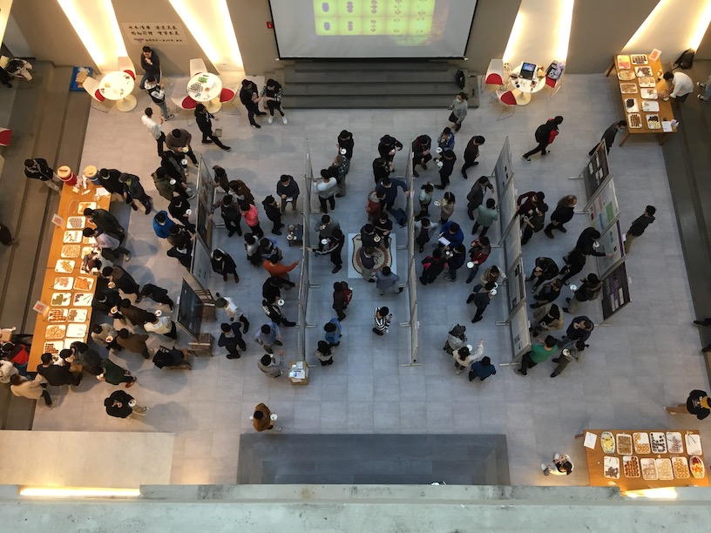
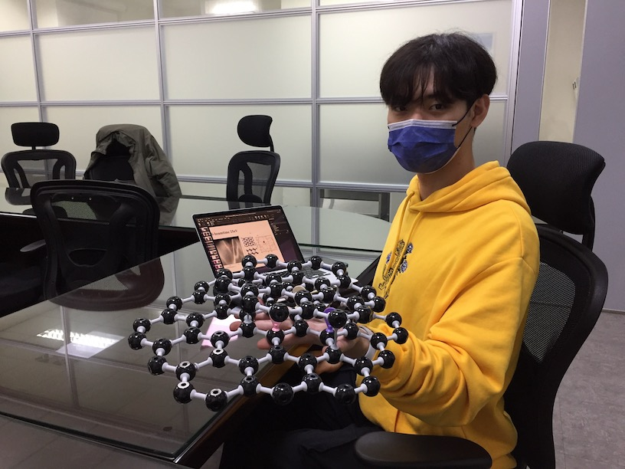

Slide 13
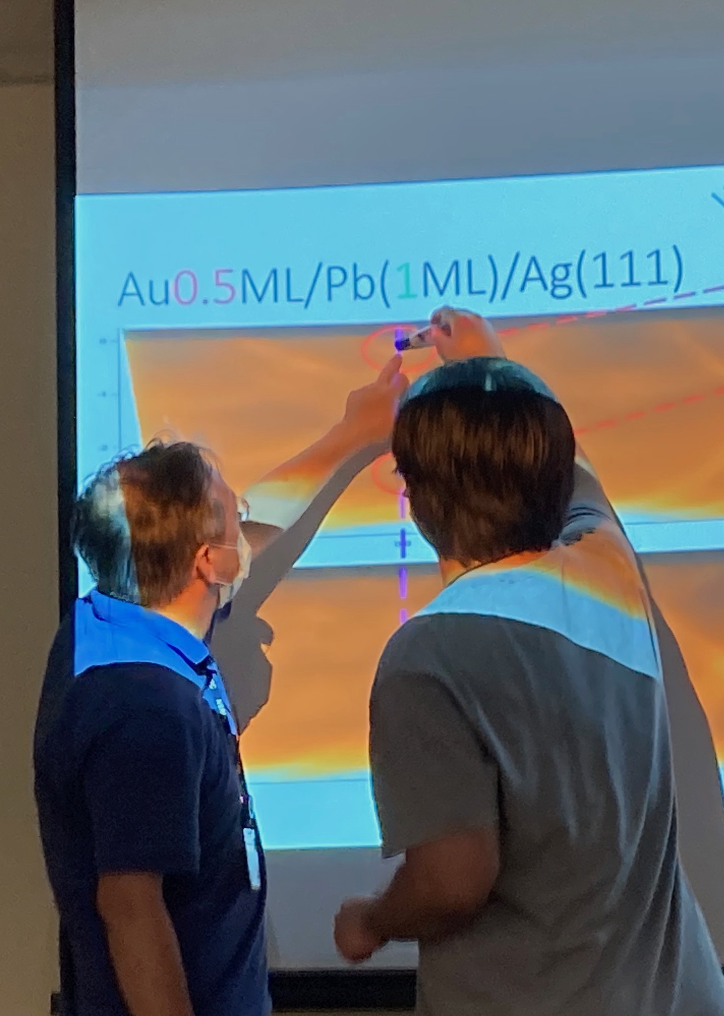
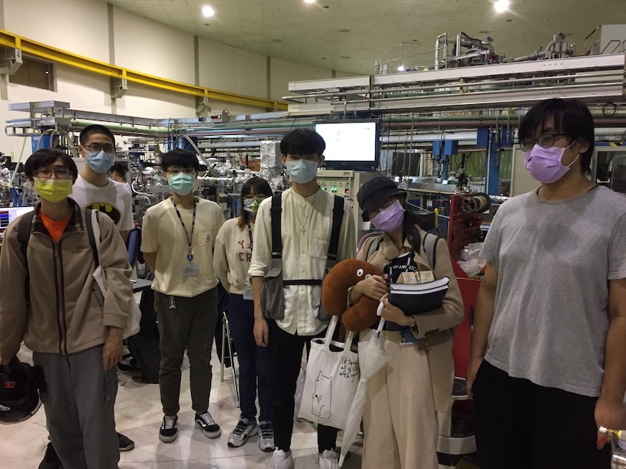

Slide 14
A-B stacked
bilayer graphene
(or is it silicene?)
(or plumbene?)
(or germanene?)
(or... stay tuned!)

Slide 15
Outline
What are "atomistic" models?
And why do we need them?
Why is surface science interesting and important?
What are 2D materials?
Simple, abstracted case of 1D beads and springs to illustrate basic idea of finding surface structure using Python
Extension to 2D
FIRE algorithm
Molecular dynamics with LAMMPS (& Python)
Visualization with Blender (& Python)
03:00

Slide 16
1
04:10

Slide 17
What are "atomistic" models?
And why do we need them?

Slide 18
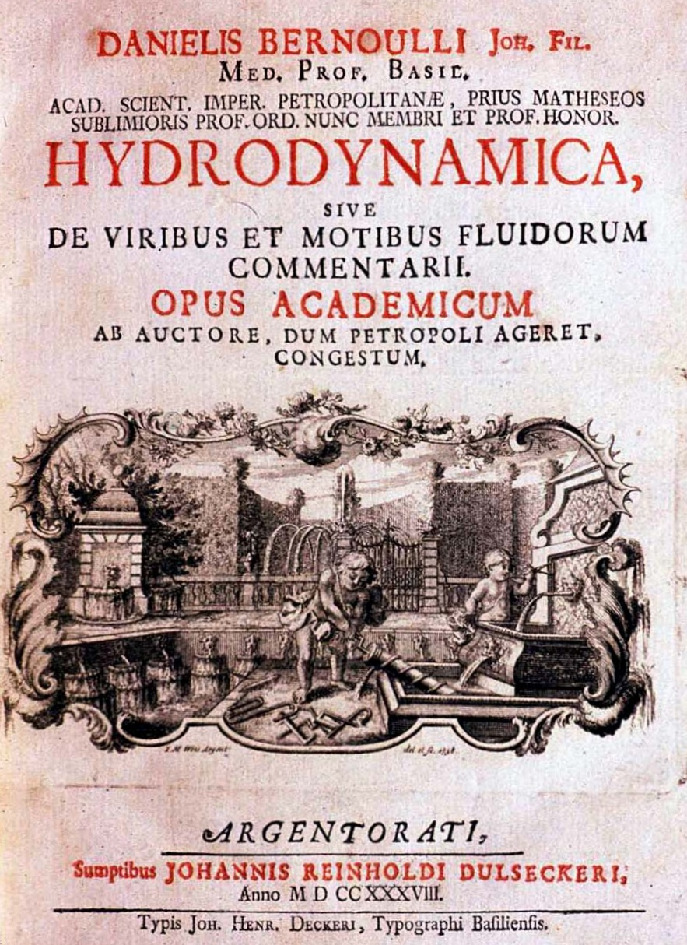
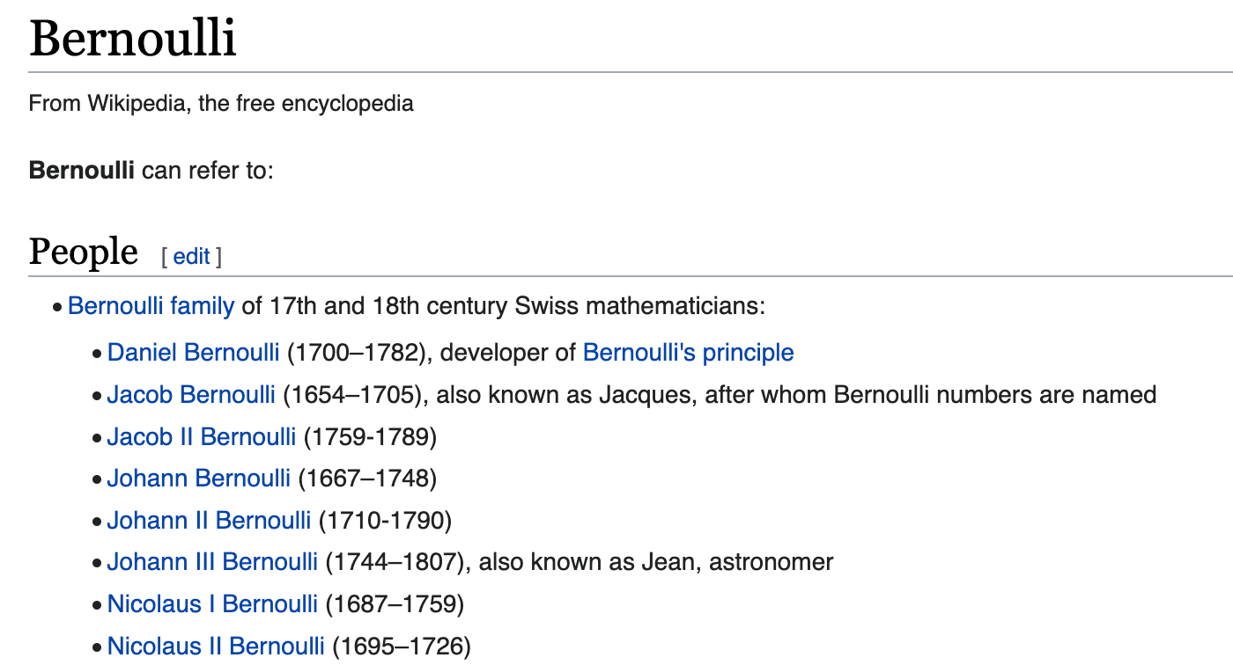
Early work was not on gases or solids, it was on fluids. Water in fact.
Thus we now have hydrodyanmics (or fluid dynamics): Bernoulli, Euler...
https://en.wikipedia.org/wiki/Leonhard_Euler
https://en.wikipedia.org/wiki/Bernoulli
https://commons.wikimedia.org/wiki/File:HYDRODYNAMICA,_Danielis_Bernoulli.png
04:00

Slide 19
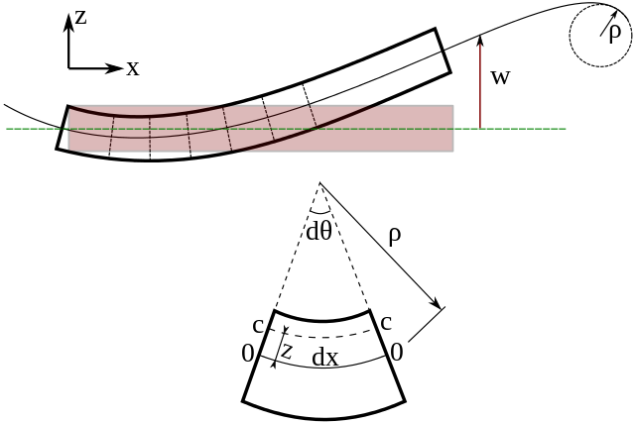
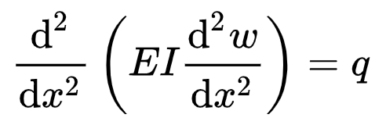
Early work on the behavior of matter also included other forms of continuum mechanics, e.g. https://en.wikipedia.org/wiki/Euler–Bernoulli_beam_theory
How a beam elastically bends was "understood", but how and why it breaks, or deforms permanently, or why heating, cooling and/or quenching affected those was a different matter. (ideas like atoms, metalurgy would come much later)
https://commons.wikimedia.org/wiki/File:Euler-Bernoulli_beam_theory-2.svg

Slide 20
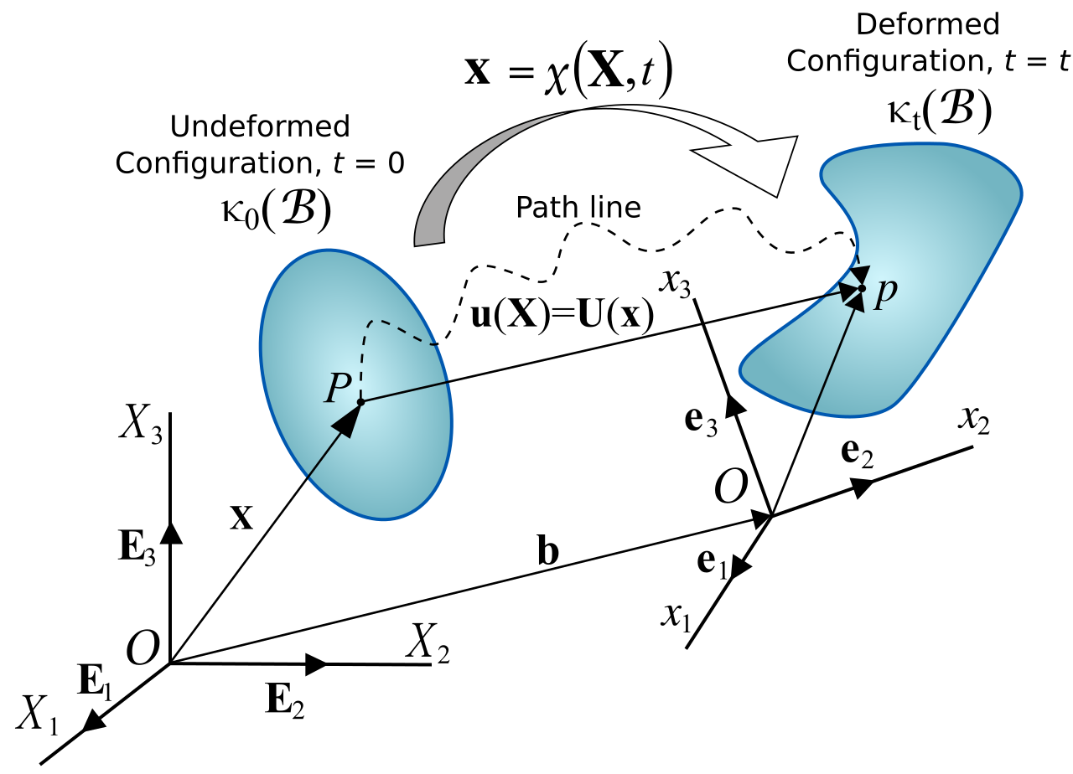
which evolved into a more general Continuum Mechanics https://en.wikipedia.org/wiki/Continuum_mechanics
behavior like
flow
melt
ooze
drip
pour
bounce
more difficult
spray
boil
freeze
intermix
https://en.wikipedia.org/wiki/File:Displacement_of_a_continuum.svg

Slide 21
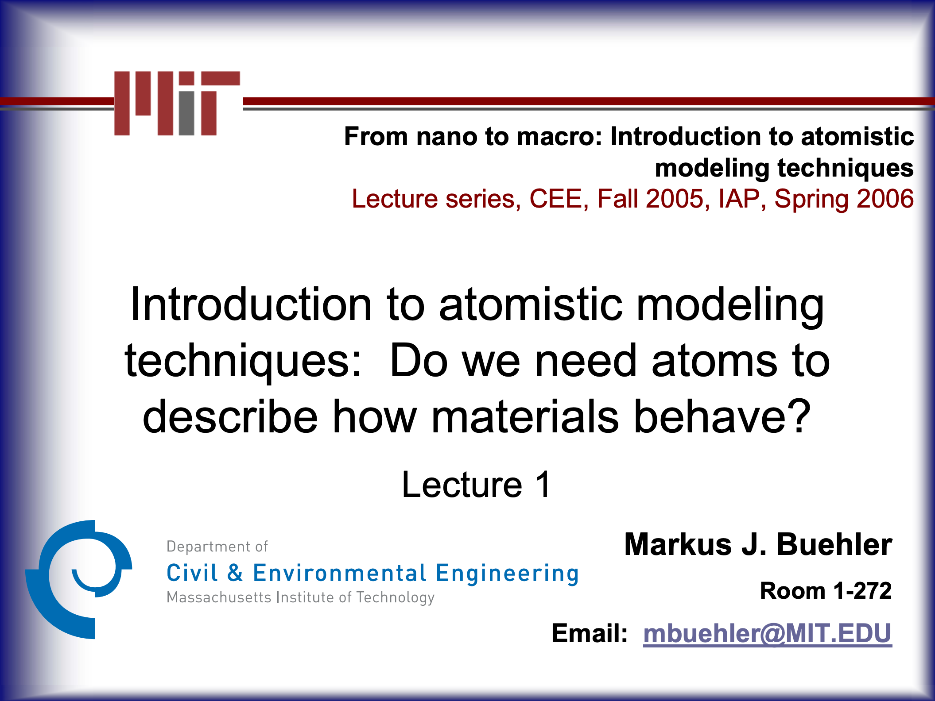
https://web.mit.edu/mbuehler/www/Teaching/LS/lecture_1_nano-macro-buehler.pdf
See also: http://web.mit.edu/mbuehler/www/Teaching/LS/lecture-1-supp.htm
05:00

Slide 22
For completeness I'll just mention DFT and AI
Quantum-mechanical, focuses on electron wave function (approximation) but results in an atomic configuration energy which can then be minimized to predict structure https://en.wikipedia.org/wiki/Density_functional_theory And there is even https://en.wikipedia.org/wiki/Time-dependent_density_functional_theory
AI Deep Mind https://www.science.org/content/article/new-era-digital-biology-ai-reveals-structures-nearly-all-known-proteins see https://www.nature.com/articles/d41586-022-02083-2

Slide 23
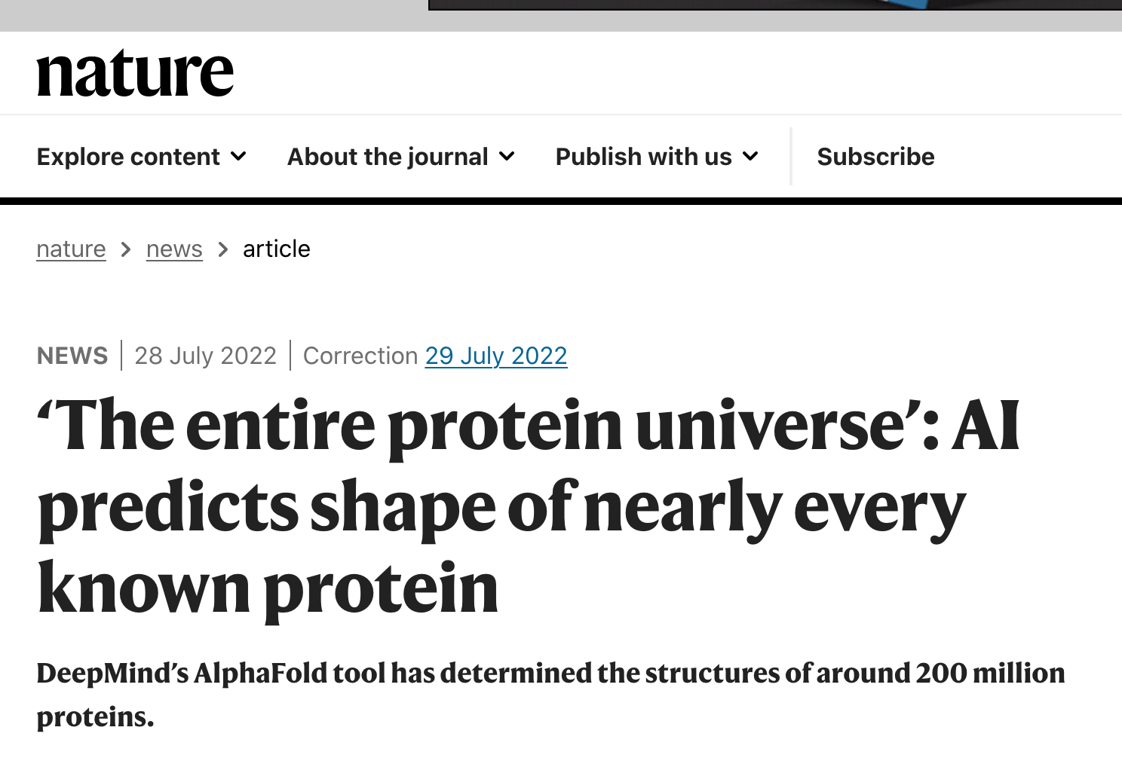
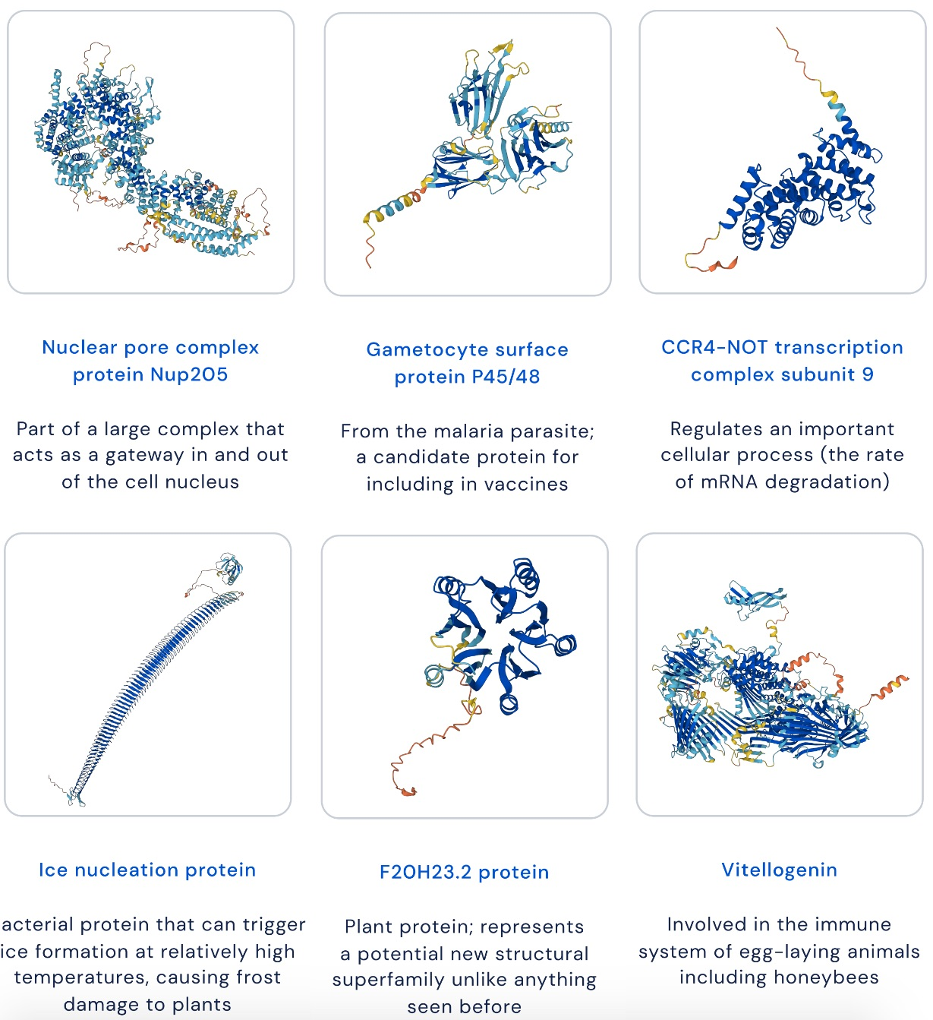
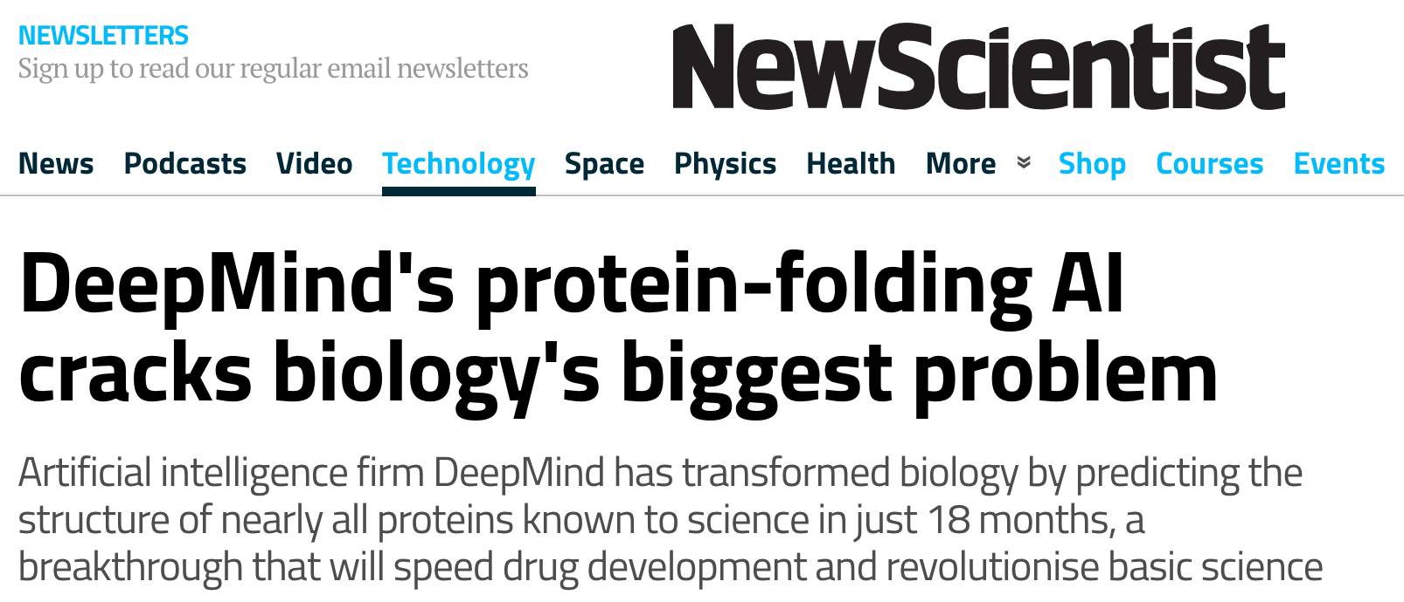
https://www.deepmind.com/blog/alphafold-reveals-the-structure-of-the-protein-universe
https://www.nature.com/articles/d41586-022-02083-2

Slide 24
2
05:00

Slide 25
2. Why is surface science interesting and important?
What are 2D materials?
07:00

Slide 26
Surfaces are the "meeting place" for atoms to do interesting things together
Catalysis (diversity of industrial processes)
Oxidation (rust)
Cell surfaces (biology)
2D materials show emergent properties
Potential for new devices

Slide 27
First 2D material to really become well known to the general public is graphene
https://en.wikipedia.org/wiki/Graphene
then came many more Xenes
then HBN, BP, TMDs
then 2D heterostructures
Some of these have "emergent properties"
https://en.wikipedia.org/wiki/Emergence#Emergent_properties_and_processes
(snowflakes)
optical, low temperature quantum mechanical, superconducting, quantum computing but these are all generally potential applications.
There's even journal for carbon forms, fullerenes, graphene conferences, etc.

Slide 28
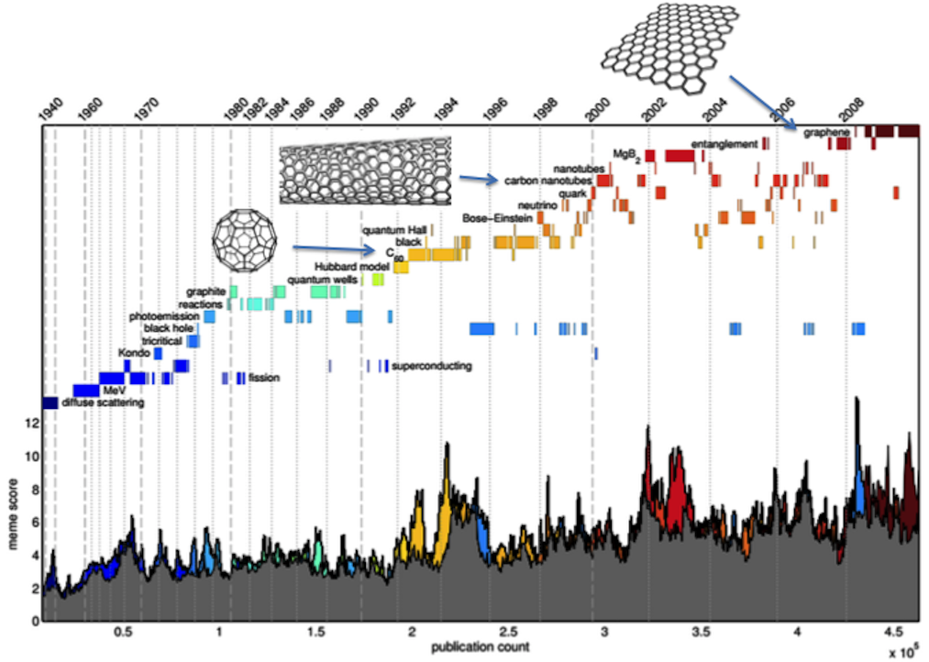
https://arxiv.org/abs/1404.3757
Inheritance patterns in citation networks
reveal scientific memes
Twisted multilayers,
Xenes, HBN, BP, TMDs,
2D heterostructures...

Slide 29
Then there's twisted bilayer graphene
and multilayer twisted graphene
https://news.mit.edu/2022/superconducting-graphene-family-0708
Magic-Angle Multilayer Graphene- A Robust Family of Moiré Superconductors 2112.10760.pdf (https://arxiv.org/abs/2112.10760)
All of these are called van der Waals materials, since the forces holding the layers together are weaker and not like real atom-atom bonds.
https://en.wikipedia.org/wiki/Van_der_Waals_force
https://en.wikipedia.org/wiki/London_dispersion_force
https://en.wikipedia.org/wiki/Intermolecular_force#Debye_force
https://en.wikipedia.org/wiki/Intermolecular_force#Keesom_force
08:00

Slide 30
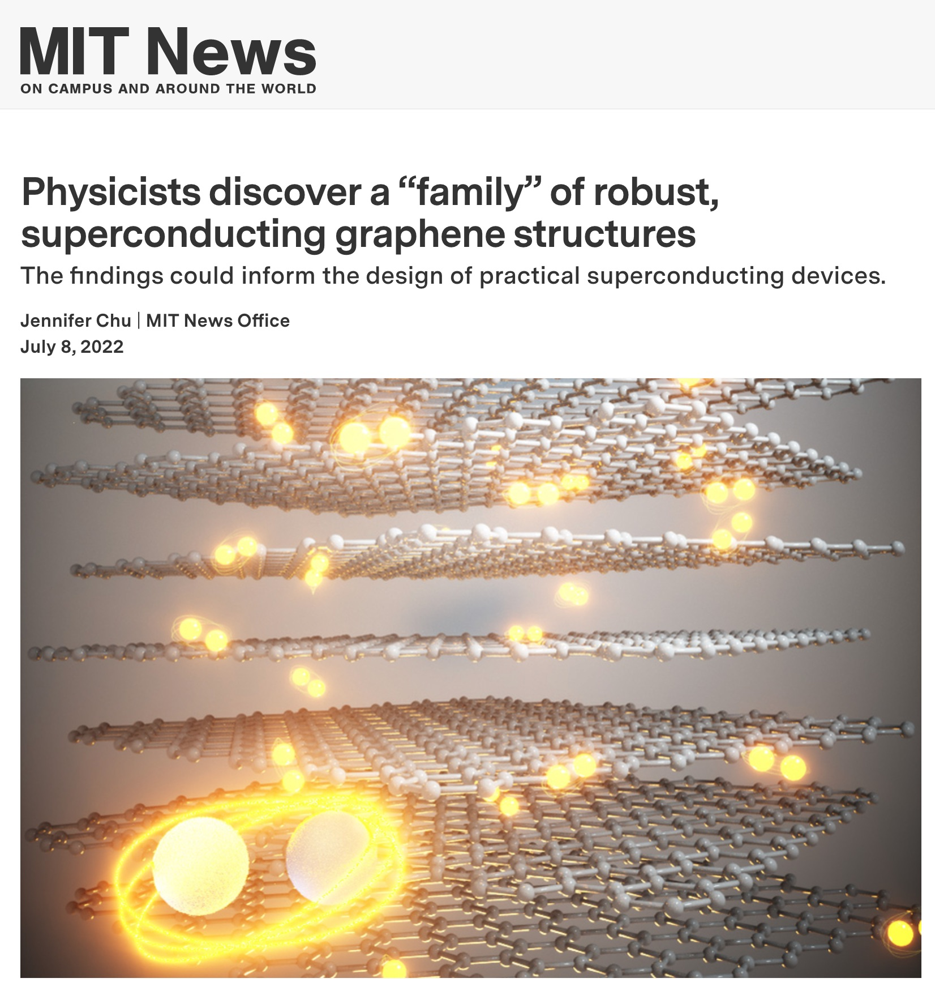
https://news.mit.edu/2022/superconducting-graphene-family-0708

Slide 31
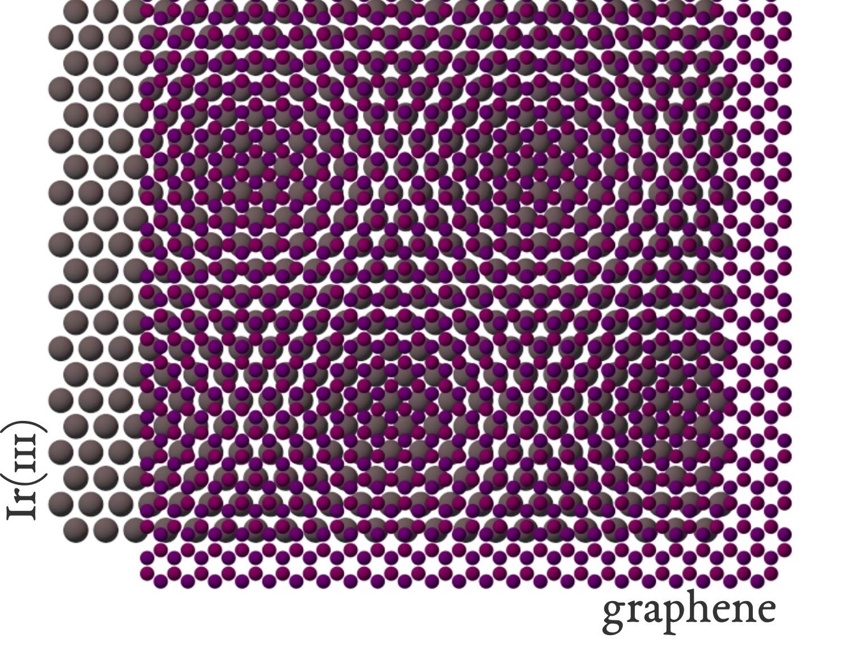
https://commons.wikimedia.org/wiki/File:Graphene_moire_on_Ir(111)_-_schematic.svg

Slide 32

Higher Order Coincidence lattice
(HOC)
https://matplotlib.org/stable/api/widgets_api.html "Python Science GUIs" next year?
09:00

Slide 33


Moire lattice

Slide 34


https://journals.aps.org/prresearch/abstract/10.1103/PhysRevResearch.3.033138 (open access)
10:00

Slide 35
In Prof. Tang's lab we make various materials:
metal layers and Xenes and alloys and mixtures
So let's get back to modeling these vdW materials.
(usually not covalent or metallic bonding)
How do they stick to surfaces and especially how do they rotate?
Let's go back to balls and springs

Slide 36
3

Slide 37
3. Simple, abstracted case of 1D balls and springs to illustrate basic idea of finding surface structure using Python
Extension to 2D & FIRE algorithm

Slide 38

We can start by looking at the classic "Frenkel-Kontorova" or "Frank-Van der Merwe" model
atoms as point masses
connected by springs representing atomic bonds
interaction with surface as a weak, sinusoidal modulation in energy
Without the modulation the lowest energy configuration is equal spaced atom.
With modulation (surface interaction) the atoms move to new positions to minimize total energy.
Energy in springs increases (strain), but offset by decrease due to attraction to substrate
Aperiodic Crystals: From Modulated Phases to Quasicrystals
Ted Janssen, Gervais Chapuis, Marc de Boissieu (2007)
Oxford Academic
Yakov Frenkel & Tatiana Kontorova
Jan van der Merwe & Frederick Charles Frank
https://books.google.com./books?id=mxRbDwAAQBAJ&pg=PA413&lpg=PA413
11:00

Slide 39
F = ma (Newton's 2nd law of motion)
a = dv/dt = F/m
Solve these:
dv/dt = F/m
dx/dt = v
and add damping:
dv/dt = F/m – const. * v
As "initial value problem" or IVP using these ingredients:
initial state vector: position and velocity [x, y, z, vx, vy, vz]
mass
interaction characteristics
external forces

Slide 40
harmonic oscillator potential (hookes law, one spring)
E = (k/2)(x-a)^2
F = -dE/dx = -k(x-a)
(Leonnard-Jones)
Dynamics:
dv/dt = a = F/m
dx/dt = v
Then we integrate. There are many, many, many ways to integrate.
Scipy.integrate has a few methods, and they have many options.
These are fast because they are classic numerical recipes generally in complied code like FORTRAN
29:00

Slide 41
from scipy.integrate import solve_ivp
demo_01_planets.py (introduce solving IVP and state vectors)
demo_02_beads_fixed_endpoints.py
demo_03_beads_periodic_BC.py (explore damping)
demo_03_beads_periodic_BC.py (explore masses)
demo_04_beads_add_a_potential.py (explore periodic force)
12:00 to 22:00

Slide 42
Other methods:
from scipy.optimize import minimize
demo_05_beads_minimize.py (explore periodic force)
And then (simple, instructive Python implementations):
demo_06_beads_simulated_annealing.py
(didn't use scipy.optimize.dual_annealing)
demo_07_beads_FIRE.py
22:00 to 28:00

Slide 43
Now we'll look at the FIRE algorithm which sped up the dynamics calculation.
Basically, to speed to the bottom you don't need to do it accurately, so instead of a fancy integrator, just use a modified Verlet with decision making to add a coarse damping. https://en.wikipedia.org/wiki/Verlet_integration#Velocity_Verlet
It might not be sufficiently fast+accurate if you cared about the trajectory details, but just to get to the bottom, who cares!
And for dynamical calculations MD provides other ways to "reset" thermodynamic properties like temperature and pressure to make of for accumulation of small numerical inaccuracies.

Slide 44
Now we'll look at the FIRE algorithm which sped up the dynamics calculation.
FIRE - Fast Inertial Relaxation Engine for Optimization on All Scales, P. Koskine et al. (2006)
Assessment and optimization of the fast inertial relaxation engine (fire) for energy minimization in atomistic simulations and its implementation in LAMMPS 1-s2.0-S0927025620300756-main.pdf
Molecular Dynamics 2006 FIRE Structural Relaxation Made Simple.pdf

Slide 45
Now let's build an island of atoms hexagonal
numpy arrays for atom positions and velocities
numpy indexing for bonds
example three atoms:
x = [[0, 1], [1, 0], [.7, .7]...]
v = [[0, 0], [0, 0], [0, 0]...]
bonds = [[0, 1], [0, 2], [1, 2]...]

Slide 46


Slide 47


Slide 48

Python model is running out of steam
Now that we understand some basics of how molecular dynamics works and some of the behaviors we're looking at, it's time to either:
Move to home-grown compiled code with Python wrapper
Start to learn and use a full-blown "grown-up" code

Slide 49
4

Slide 50
4. Molecular dynamics with LAMMPS (& Python)
LAMMPS stands for:
Large-scale Atomic/Molecular Massively Parallel Simulator
https://www.lammps.org/
(macOS, Linux, Windows)
31:00

Slide 51


Over 6,000 papers per year!
"LAMMPS molecular dynamics"

Slide 52


Slide 53


https://docs.lammps.org/Manual.html
32:00

Slide 54




excellent detailed explanation of input files
vSmq2IjktYA
QdygibMW1AI
7Ila18g8zSY
GXA2PyqKYdY

Slide 55

https://youtu.be/R6A3fS1N9vk
33:00

Slide 56


Slide 57
LAMMPS Latin American Introductory School on Parallel Programming and Parallel Architecture for High-Performance Computing Dr. Richard Berger lammps.pdf
https://docs.lammps.org/Python_head.html

Slide 58

step_x = a_111 = a_fcc/root2
step_y = a_111 * root3
= (root3/root2) * a_fcc
step_z = a_fcc / root3
dx = [0, 0.5, 0 ]* a_111
dx = [0, 1/root8, 0] * a_fcc
dy = [0, (1/3)*root3/2, (2/3)* root3/2] * a_111
dy = [0, 1/root24, 1/root6] * a_fcc
dz = [0, 0, 0] * a_111
dz = [0, 0, 0] * a_fcc
atom_2 = [0.5, root3/2, 0] * a_111
atom_2 = [1/root8, root3/root8, 0] * a_fcc
https://www.researchgate.net/figure/Color-online-Top-view-of-the-high-symmetry-adsorption-sites-fcc-hcp-bridge-and-top-on_fig1_235523155

Slide 59
LAMMPS demo
fccbox_v02.py (generates atoms.input file)
fccbox_v02.in (written by hand this time)
conda activate my-lammps-env
lmp_serial -in fccbox_v02.in
OVITO demo
wow.mov
BLENDER demos
/Applications/blender2.app/Contents/MacOS/blender
34:00

Slide 60
5

Slide 61
Visualization with Blender (& Python)
40:00

Slide 62

Thank you for your time!
david.mikolas1@gmail.com
45:00

